Slide 1
File Management

Slide 2
Introduction to File Management
Some application require input to be taken from a file and output is required to be stored in a file.
The ‘C’ language provides the facility of file input-output operations.
The standard library in C has many file I/O functions.
File is a place on disk where a group of related data is stored.
Sequence of steps for operating on a file:
Naming or creating a file
Opening a file
Reading or writing to the file
Closing the file

Slide 3
Opening a file
While working with file, you need to declare a pointer of type file. This declaration is needed for communication between file and program.
FILE *fp; -- declaration
Opening a file is performed using library function fopen(). The syntax for opening a file in standard I/O is:
fp = fopen (“filename”, “mode”);
For example, fp = fopen("E:\\cprogram\\program.txt","w");
In the above statement, fp is a pointer to the data type FILE. The above statement opens a file named filename and assigns an identifier to the FILE type pointer fp. This pointer which contains all the information about the file, is subsequently used as a communication link between the system and the program.
The function fopen returns a pointer to the opened file stream. The parameter filename is the name of the file to be opened. The mode string can have one of the values showed in the table.

Slide 4
Opening a file
Mode string for fopen( )
Mode | Description
r | Open file for reading only
w | Open file for write purpose. Create for writing and if the file already exist, it will be overwritten
a | Append, open for writing at end of file (create for writing if doesn’t exist)
r+ | Open an existing file for update (reading or writing)
w+ | Create a new file for update. If it already exists, it will be overwritten
a+ | Open for append, open for update at the end of the file.

Slide 5
Closing a file
The file should be closed after reading/writing of a file. Closing a file is performed using library function fclose().
fclose(file_pointer);
For example, fclose(fp);

Slide 6
Input/output operations on a file
Function Name | Operation
fopen( ) | Open the file for use
fgetc( ) | Read a character from the file (text file)
fputc( ) | Writes a character to the file (text file)
fclose( ) | Close a file, which is open by file pointer
fprintf( ) | Write a set of data values to files (text file)
fscanf( ) | Read a set of data values from files. (text file)
fputs( ) | Write string to file (text file)
fgets( ) | Read string from file (text file)
fread( ) | Read records (sequence of bytes) to the file. (binary file)
fwrite( ) | Write records (sequence of bytes) to the file. (binary file)
getw( ) | Read an integer from a file
putw( ) | Write an integer to a file

Slide 7
fgetc( ) and fputc( ) functions
The function fgetc( ) and fputc( ) are used to perform character reading and writing from files. Assume that a file is opened with mode write and file pointer fp1.
Following statement,
fputc(c, fp1);
Where fp1 is file pointer and c is character type variable, which write character c at fp1 position in the file.
Similarly, the fgetc( ) reads one character at a time from the file opened in read mode and moves the file pointer to next position.
c = fgetc(fp);
Where c is a character type variable, fp is a file pointer.
Refer the program fgetc.c , fputc.c & copy.c

Slide 8
fscanf( ) and fprintf( ) functions
For handling group of different data types from file at a time, fscanf( ) and fprintf( ) function is used. The general format of the fscanf( ) is given below:
fscanf(fp, “control string”, &arguments);
Where fp is a file pointer associated with file that has been opened for reading. The control string contains output specifications for the items in the list. The list may include variables, constants and string.
For example, in the following code,
int a;
char b;
fscanf(fp, “%d %c”, &a, &b);
Here, a and b are variables in which data is read from file into variables.

Slide 9
fscanf( ) and fprintf( ) functions
The general format of the fprintf( ) is given below:
fprintf(fp, “control string”, list);
Where fp is a file pointer associated with file that has been opened for writing. The control string contains output specifications for the items in the list. The list may include variables, constants and string.
For example, in the following code,
fprintf(fp, “%s %d”, city, total);
Here, city is an array variable of type char and total is an int variable.
Refer the program fprintf.c and fscanf.c

Slide 10
fgets( ) and fputs( ) functions
The C library function char *fgets(char *str, int n, FILE *stream) reads a line from the specified stream and stores it into the string pointed to by str. It stops when
either (n-1) characters are read
the newline character is read
or the end-of-file is reached, whichever comes first.
Following is the declaration for fgets() function.
char *fgets(char *str, int n, FILE *stream)
Parameters
str -- This is the pointer to an array of chars where the string read is stored.
n -- This is the maximum number of characters to be read (including the final null-character). Usually, the length of the array passed as str is used.
stream -- This is the pointer to a FILE object that identifies the stream where characters are read from.
Refer program fgets.c

Slide 11
fgets( ) and fputs( ) functions
The C library function int fputs(const char *str, FILE *stream) writes a string to the specified stream up to but not including the null character.
Following is the declaration for fputs() function.
int fputs(const char *str, FILE *stream)
Parameters
str -- This is an array containing the null-terminated sequence of characters to be written.
stream -- This is the pointer to a FILE object that identifies the stream where the string is to be written.
Refer program fputs.c

Slide 12
fwrite( ) function
The fwrite() function is used to write records (sequence of bytes) to the file. A record may be an array or a structure.
Syntax of fwrite() function
fwrite( ptr, int size, int n, FILE *fp );
The fwrite() function takes four arguments.
ptr : ptr is the reference of an array or a structure stored in memory.
size : size is the total number of bytes to be written.
n : n is number of times a record will be written.
FILE* : FILE* is a file where the records will be written in binary mode.

Slide 13
fread( ) function
The fread() function is used to read bytes form the file.
Syntax of fread() function
fread( ptr, int size, int n, FILE *fp );
The fread() function takes four arguments.
ptr : ptr is the reference of an array or a structure where data will be stored after reading.
size : size is the total number of bytes to be read from file.
n : n is number of times a record will be read.
FILE* : FILE* is a file where the records will be read.

Slide 14
getw( ) and putw( )function
putw(), getw() functions are file handling function in C programming language which is used to write an integer value into a file (putw) and read integer value from a file (getw).
Declaration: int putw(int number, FILE *fp);
putw function is used to write an integer into a file.
putw(i, fp); where i is integer value and fp is file pointer.
Declaration: int getw(FILE *fp);
getw function reads an integer value from a file pointed by fp.
getw(fp);
Refer program putw_getw.c

Slide 15
Random File Operations
IO is not confined to sequential motion through a file. May also shift the file position back and forth to any specified location.
Three functions:
long ftell(FILE *fp);
int fseek(FILE *fp, long offset, int from);
void rewind(FILE *fp);

Slide 16
ftell( ) function
Declaration: long int ftell(FILE *fp)
ftell function is used to get current position of the file pointer. In a C program, we use ftell() as below. ftell(fp);
Refer program ftell_rewind.c

Slide 17
rewind( ) function
rewind function is used to move file pointer position to the beginning of the file
Declaration: void rewind(FILE *fp)
In a C program, we use rewind() as below. rewind(fp);
Refer program ftell_rewind.c

Slide 18
fseek( ) function
fseek() function is used to move file pointer position to the given location.
Declaration: int fseek(FILE *fp, long int offset, int whence)
where, fp – file pointer
offset – Number of bytes/characters to be offset/moved from whence/the current file pointer position
whence – This is the current file pointer position from where offset is added. Below 3 constants are used to specify this.
SEEK_SET – It moves file pointer position to the beginning of the file.
SEEK_CUR – It moves file pointer position to given location.
SEEK_END – It moves file pointer position to the end of file.
Refer program fseek.c

Slide 19
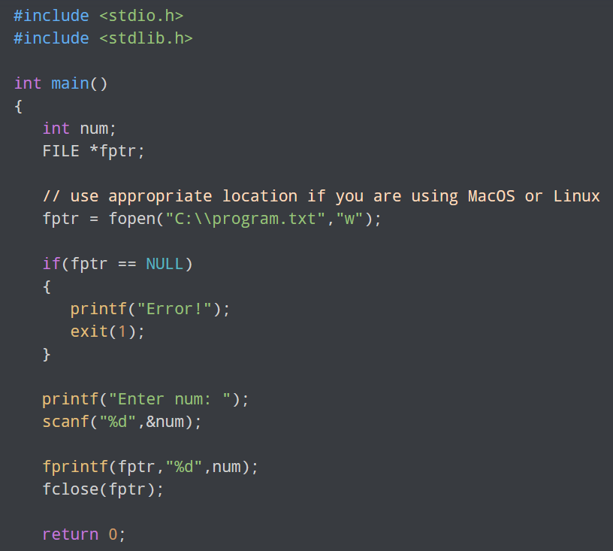
Write to a text file

Slide 20
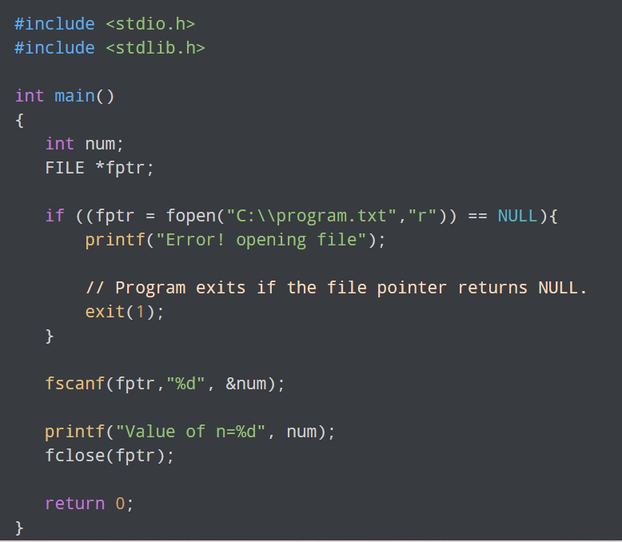
Read from a text file

Slide 21
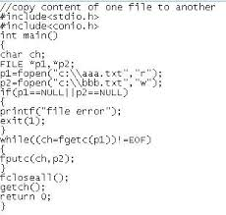
Copy the contents of one file into another

Slide 22
Command line arguments
Command line arguments are parameter or arguments passed to a program when it runs from command prompt.
Example: C:\tc\bin > file1 a.txt b.txt
Where file1 is the program name where executable code of the program is stored, and a.txt is the first argument passed to the program and b.txt is the second argument passed to the program.
These arguments are recognized into program by main( ) method. For handling command line arguments, main( ) function has to be written with two arguments are shown below:
void main (int argc, char *argv[ ])
argc is argument count and argv array stores arguments passed to program.
For example, argv [0] = file1, argv[1] = a.txt, argv[2] = b.txt
The first parameter in the command line is always the program name and therefore argv[0] always represents the program name.
Refer the program commandline.c

Slide 23
Thank you!!!

